Slide 1
BONY PELVIS
DR. L. GIRIJA. M.D. (Hom.),
Associate professor,
DEPARTMENT OF GYNAECOLOGY AND OBSTETRICS,
SARADA KRISHNA HOMOEOPATHIC MEDICAL COLLEGE,
KULASEKHARAM

Slide 4
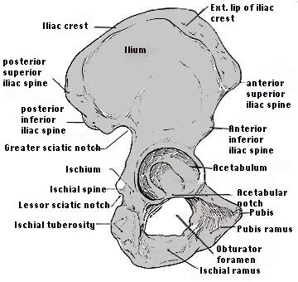
INNOMINATE BONE

Slide 5
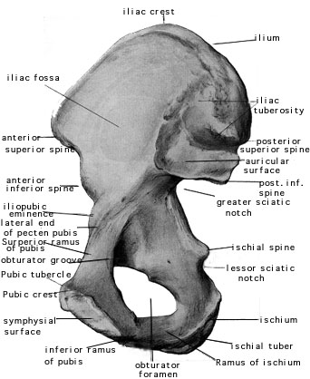

Slide 6
Sacrum
The sacrum is a solid bone formed from the five fused sacral vertebrae with an intervening vertebral disc.
One Ilium on each side, articulates with the sacrum with a pseudo-synovial joint.
The sacrum curves anteriorly near its tapered lower tip, where it articulates with coccyx.

Slide 7
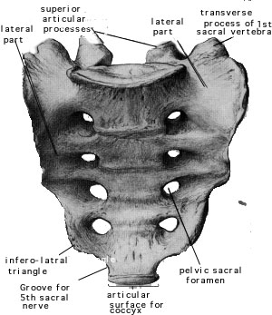

Slide 8
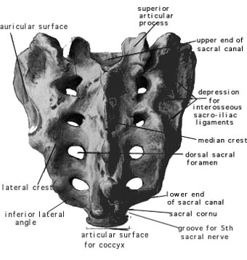

Slide 9
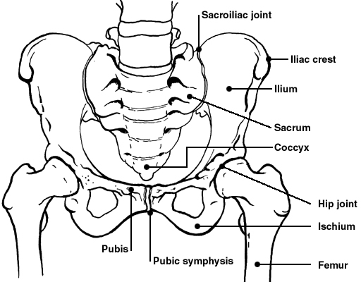

Slide 10
PELVIS
The pelvis is divided by an oblique plane passing through the prominence of the sacrum, the arcuate and pectineal lines, and the upper margin of the symphysis pubis, into the greater and the lesser pelvis.
The circumference of this plane is termed the linea terminalis or pelvic brim.

Slide 11
The Greater or False Pelvis (pelvis major)
The greater pelvis is the expanded portion of the cavity situated above and in front of the pelvic brim.
It is bounded on either side by the ilium; in front it is incomplete, presenting a wide interval between the anterior borders of the ilia, which is filled up in the fresh state by the parietes of the abdomen; behind is a deep notch on either side between the ilium and the base of the sacrum.
It supports the intestines, and transmits part of their weight to the anterior wall of the abdomen.

Slide 12
The Lesser or True Pelvis (pelvis minor)
The lesser pelvis is that part of the pelvic cavity which is situated below and behind the pelvic brim.
Its bony walls are more complete than those of the greater pelvis.
For convenience of description, it is divided into an inlet bounded by the superior circumference, and outlet bounded by the inferior circumference, and a cavity.

Slide 13
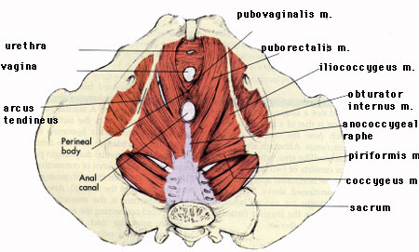

Slide 14
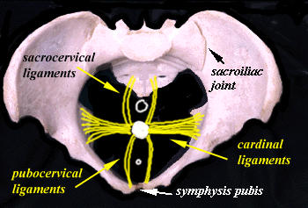

Slide 16
External diameters
Inter spinous diameter. Distance between outre lips of anterosuperior iliac spine about 25cm.
Intercristal diameter. Distance between outre lips of iliac crests at the widest part about 27.5cm.
External cojugate (Diameter of Baudlocque) Distance between depression just belowThe spinous process of last lumbar vertabra and the most prominent point on the antero-sup surface ofsymphysis pubis in the mid line about 20cm.
Inter-trochanteric diameter. Maximum width between greater trochanters about 31cm.
(These diameters have no clinical values)

Slide 17
Superior aperture or inlet
The superior circumference forms the brim of the pelvis, the included space being called the superior aperture or inlet
It is formed laterally by the pectineal and arcuate lines, in front by the crests of the pubes, and behind by the anterior margin of the base of the sacrum and sacrovertebral angle.
The superior aperture is somewhat heart-shaped, obtusely pointed in front, diverging on either side, and encroached upon behind by the projection forward of the promontory of the sacrum.
It has three principal diameters: antero-posterior, transverse, and oblique.

Slide 18
Superior aperture or inlet…
Diagonal conjugate extends from the sacralpromontory to the inner inferior boarder of symphysis pubis; its average measurement is about 11.5 cm. in the female.
True conjugate is measured by reducing 1.5-2cm from diagonal conjugate.
More must be redused
If pubic symphysis is more deeper,Inclination of pubis is more,Hieght of promntory is more.

Slide 19
Superior aperture or inlet…
The transverse diameter extends across the greatest width of the superior aperture, from the middle of the brim on one side to the same point on the opposite; its average measurement is about 13.5 cm. in the female.
The oblique diameter extends from the iliopectineal eminence of one side to the sacroiliac articulation of the opposite side; its average measurement is about 12.75 cm. in the female.

Slide 20
inlet

Slide 21
cavity
The cavity of the lesser pelvis is bounded in front and below by the pubic symphysis and the superior rami of the pubes;
Above and behind, by the pelvic surfaces of the sacrum and coccyx, which, curving forward above and below, contract the superior and inferior apertures of the cavity;
laterally, by a broad, smooth, quadrangular area of bone, corresponding to the inner surfaces of the body and superior ramus of the ischium and that part of the ilium which is below the arcuate line.
From this description it will be seen that the cavity of the lesser pelvis is a short, curved canal, considerably deeper on its posterior than on its anterior wall.
It contains, in the fresh subject, the pelvic colon, rectum, bladder, and some of the organs of generation. The rectum is placed at the back of the pelvis, in the curve of the sacrum and coccyx; the bladder is in front, behind the pubic symphysis. In the female the uterus and vagina occupy the interval between these viscera.

Slide 22
cavity
Plane ofGreatest pelvic dimensions.It passes through junction of 2nd and 3rd sacral vertabrae laterally through ischial bone over the middle of acetabulum ,circular in shape antero-post diameter12.5cm,Transvers diameter 12.75cm
Plane of least dimensions. Extends through lower margine of symphysis pubis, tip of the sacrum and ischial spines. Antero-post diameter about 11.5cm, Transverse diamete about10.5cm.

Slide 23
inferior aperture or outlet
The lower circumference of the pelvis is very irregular; the space enclosed by it is named the inferior aperture or outlet
And is bounded behind by the point of the coccyx, and laterally by the ischial tuberosities.
These eminences are separated by three notches: one in front,
The pubic arch, formed by the convergence of the inferior rami of the ischium and pubis on either side.

Slide 24
Inferior aperture or outlet
The other notches, one on either side, are formed by the sacrum and coccyx behind, the ischium in front, and the ilium above; they are called the sciatic notches;
In the natural state they are converted into foramina by the sacrotuberous and sacrospinous ligaments.
When the ligaments are in situ, the inferior aperture of the pelvis is lozenge-shaped, bounded, in front, by the pubic arcuate ligament and the inferior rami of the pubes and ischia; laterally, by the ischial tuberosities; and behind, by the sacrotuberous ligaments and the tip of the coccyx.

Slide 25
Diameters of inferior aperture of lesser pelvis (outlet)
The diameters of the outlet of the pelvis are two, antero-posterior and transverse.
The antero-posterior diameter extends from the tip of the coccyx to the lower part of the pubic symphysis; its measurement is about 11.cm. in the female.
It varies with the length of the coccyx, and is capable of increase or diminution, on account of the mobility of that bone.
Transverse diameter (Bi ischial orInter tuberous), measured between the posterior parts of the ischial tuberosities, is about 8cm. in the female.
Post sagital diameter Distance from mid point of line between ischial tuberosities and external surface of tip of scrum about 7.0cm.

Slide 27
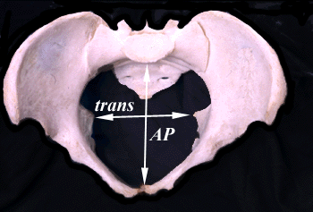

Slide 28
Pelvic inclination
The position of the pelvis in the erect posture is so that the anterior superior iliac spines and the front of the top of the symphysis pubis are in the same vertical plane. The angle formed between plane of pelvic inlet and the horizontal planeis called angle of pelvic inclination,it is increased in high assimilation pelvis(such case delay in engage ment of head)

Slide 29
Differences between the Male and Female Pelves.
The female pelvis is distinguished from that of the male by its bones being more delicate and its depth less.
The whole pelvis is less massive, and its muscular impressions are slightly marked.
The iliac fossa are shallow, and the anterior iliac spines more widely separated; hence the greater lateral prominence of the hips.
The preauricular sulcus is more commonly present and better marked.
The superior aperture of the lesser pelvis is larger in the female than in the male; it is more nearly circular, and its obliquity is greater.
The cavity is shallower and wider;

Slide 30
Differences between the Male and Female Pelves.
the sacrum is shorter wider, and its upper part is less curved;
the obturator foramina are triangular in shape and smaller in size than in the male.
The inferior aperture is larger and the coccyx more movable.
The sciatic notches are wider and shallower, and the spines of the ischia project less inward.
The acetabula are smaller and look more distinctly forward The ischial tuberosities and the acetabula are wider apart, and the former are more everted.
The pubic symphysis is less deep, and the pubic arch is wider and more rounded than in the male, where it is an angle rather than an arch.

Slide 31
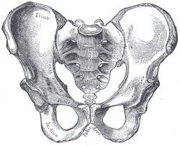
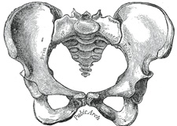
Male pelvis Female pelvis

Slide 32
Position of the Pelvis
In the erect posture, the pelvis is placed obliquely with regard to the trunk:
The plane of the superior aperture forms an angle of from 50° to 60°, and that of the inferior aperture one of about 15° with the horizontal plane.
The pelvic surface of the symphysis pubis looks upward and backward,
The concavity of the sacrum and coccyx downward and forward.
The position of the pelvis in the erect posture may be indicated by holding it so that the anterior superior iliac spines and the front of the top of the symphysis pubis are in the same vertical plane.

Slide 33
Munro-kerr’s classification
Deformities arising from faulty devolopment
Deformities arising from deseases of pelvic bone and joint.
Deformities arising from deseases of spinal column
Deformities arising from deseases oflower extremities.

Slide 34
Deformities arising from faulty devolopment
Justo major pelvis
Justo minor pelvis
Simple flate non-rachetic pelvis
Naegel’s pelvis –Imperfect devolopment of one sacral alae.
Robert’s pelvis-Imperfect devolopment of both sacral alae.
Split pelvis- Imperfect devolopment of pubis.
Assimilation pelvis.

Slide 35
Deformities arising from deseases of pelvic bone and joint.
Rickets
Osteomalacia
New growth.
Fractures
Atrophy caries, Necrosis
Diseases of sacro- iliac sacro- cocceagial joint
Luxation of sacro iliac joint

Slide 36
Deformities arising from deseases of spinal column
Kyphosis
Scoliosis
Spondylolisthesis(Displasement of vertabra over lower segment usually4th or5th due to devolopmental deffect)

Slide 37
Deformities arising from deseases of lower extremities.
Deformities arising from disease of lower extremities
Coxitis
Atrophy or loss of one limb
Dislocation of one or both femur

Slide 38
Caldwell-Moloy Classification
Gynecoid Pelvis (50%)
Android Pelvis (Male type)
Anthropoid Pelvis
Platypelloid Pelvis (3%)

Slide 39
Anthropoid Pelvis
Pelvic brim is an anteroposterior oval
Much more common in black women
Transeverse diameter narrow
Antero-post diameter longer
Width of sacrum reduced
Post segment of inlet Long and narrow
Sacrosciatic notch wider
Pelvic side wallsstraight
Subpubic arch moderate
Inter-spinous diameter narrow
Inter-tuberous diameter narrow
Sub pubic arch narrow

Slide 40
Gynecoid Pelvis (50%)
Pelvic brim is a transverse ellipse (nearly a circle)
Most favorable for delivery
Transvers diameter is longer than antero posterior
Sacro sciatic notch-Medium size
Sacral curve average
Subpubic arch wider
Pelvic side walls straight
Inter-spinous diameter wide
Inter-tuberous diameter wide

Slide 41
Android Pelvis (Male type)
Inlet wedge shaped
Convergent Side Walls (widest posteriorly)
Prominent ischial spines
Narrow subpubic arch
More common in white women
Inter-spinous diameter narrow
Inter-tuberous diameter narrow
Sacrum straight with forward inclination

Slide 42
Platypelloid Pelvis (3%)
Pelvic brim is transverse kidney shape
Flattened gynecoid shape
Antero-post diameter narrow
Transvers diameter is wide
Sacro sciatic notch-Medium size
Pelvic side walls straight
Subpubic arch wider
Shallow pelvis

Slide 43
Gynecoid (normal female pelvis)

Slide 44
 | Gynecoid (normal female pelvis) | Android (Funnel shaped pelvis)
Inlet | heart shaped | wedge shaped
Sacrum | curved | Straight
Sacro sciaticnotch | medium width | narrow
Side walls | Straight / divergent | Convergent
Pubic arch | Curved | Straight
Sub pubic angle | wide | Very narrow

Slide 45
Android (Funnel shaped pelvis)

Slide 46
Anthropoid resemble Ape’s pelvic

Slide 47
 | Anthropoid resemble Ape’s pelvic | Platy palloid (Flat pelvis)
Inlet | Anteroposteriorly ovoid shape | Tramsverse Ovoid/ kindney shape
Sacrum | Curved and long | Curved, short
Sacro sciaticnotch | Wide shallow | narrowed
Side walls | Often straight | straight/divergent
Pubic arch | Slightly curved | Curved
Sub pubic angle | Narrow | wide

Slide 48
Platy palloid (Flat pelvis)

Slide 49
Determination of an Adequate Pelvis
Diagonal conjugate
Distance from sacral promontory to symphysis pubis
Approximate length of fingers introitus to sacrum
Adequate diagonal conjugate > 11.5cm
Images
Intertuberous Diameter
Distance between Ischial tuberosities
Approximately width of fist
Adequate intertuberous diameter > 10 cm
Images
Prominence of ischial spines

Slide 50
Diagnosis of contracted pelvis
History
General Rickets,Osteomalacea,Poliomyelitis,Tuberculosisof hip joint,fracture of bonesof lower extremities and pelvis
Obstetrics
History of previos deliveries
Cephalo pelvic disproportion

Slide 51
Physical examination
Short stature (Below 150cm)
Pendulous abdomen
Spinal deformities
Shortening of lower limb
Tilting of pelvis
Waddling gait
Evidence of ricketic rosary (suggest pelvic deformity)

Slide 52
Obstetric examinations
Un engaged fetal head (Floating)
External pelvimetry
(poor accuracy-Modern obstetrics external pelvimety of brim is not usually done-pelvimety of out let gives reliable informations)
Commonly measured diameters

Slide 53
External pelvimetry
COMMONLY MEASURED DIAMETERS
Transvers diameter of outlet
The space between the tuberosity will accommodate four knuckles of closed hand(10.5-11cm)
Antero-post diameter of outlet
About 12.5cm.
Post sagital diameter of outlet
Subpubic angle
By direct palpation and vaginal exam. Average 85’0.

Slide 54
Internal pelvimetry
By instruments
Vaginal exams (Not used now)

Slide 55
Vaginal exams
Sub pubic arch.
Ischial spines.
Sacral concavity.
Length of sacro tuberous ligament.
Pelvic side walls.
Diogonal conjugate-
(from that obstetric conjugate is calculated)
Assesment of CPD (Munro-Kerr-Muller method)
Radiological assesment……

Slide 56
Radiological assesment
FOUR VIEWS ARE THERE
Direct laterral
Direct antero posterior
Superiro-post picture of brim
Superiro-post picture of out let

